Slide 1
Vaccines
Discussing the Research

Slide 2
The benefits outweigh the risks?

Slide 3
Why Research?
Chronic illness 1984: 1 in 10
Chronic illness today: “The rate of chronic health conditions among children in the United States increased from 12.8% in 1994 to 26.6% in 2006” –JAMA
Cause: Unknown environmental factors
Notes:
http://www.ncbi.nlm.nih.gov/pubmed/6199724 http://www.medscape.com/viewarticle/717030

Slide 4
What are the diseases?
Hepatitis B
Rotavirus
Diphtheria
Tetanus
Pertussis
Pneumococcal
Polio
Influenza (Yearly)
Haemophilus Influenzae B
Measles
Mumps
Rubella (German Measles)
Varicella (Chicken pox)
Hepatitis A

Slide 5
What’s the schedule?

Slide 6
What was Our schedule?

Slide 7
Global Coverage Rates
Notes:
http://whqlibdoc.who.int/hq/2009/WHO_IVB_2009_eng.pdf

Slide 8
The United States

Slide 9
1980 vs. 2000
Measles:
Coverage: 86%
Cases: 13,506
Pertussis
Coverage: 96%
Cases: 1,730
Measles:
Coverage: 95%
Cases: 85
Pertussis
Coverage: 94%
Cases: 7,867

Slide 10
In 1990
The cases of Measles went up to a whopping:
27,786
In 2006
The cases of Pertussis went up to a whopping:
25,827

Slide 11
Pertussis Outbreak: (2001-2003)
“Overall in the United States, the average annual incidence was 3.3 cases per 100,000 population” –MMWR, CDC
“The attributable risk estimates for a serious acute neurologic disorder within 7 days after DTP vaccine (regardless of outcome) was one in 110,000 doses of DTP, and for a permanent neurologic deficit, one in 310,000 doses.”
Notes:
http://www.cdc.gov/mmwr/preview/mmwrhtml/mm5450a3.htm http://www.cdc.gov/mmwr/preview/mmwrhtml/00022879.htm

Slide 12
What Does It Mean?
Despite a 95% coverage rate in the U.S., we still experienced a large scale outbreak.
The outbreak resulted in the loss of 52 people, 91% were too young to be fully vaccinated.

Slide 13
Polio Eradicated?
Notes:
http://archive.hhs.gov/nvpo/concepts/intro6.htm

Slide 14
A Closer Look

Slide 15
Polio Cases Had Declined
From 60,000 to 5,000 BEFORE the first vaccine was licensed.

Slide 16
Cancer and Vaccination
“The investigation included the polyomavirus simian virus 40 (SV40), a pathogen recognized to have infected millions of humans who were vaccinated with polio vaccines produced in cultures of rhesus monkey kidney cells” -CDC
“Increasing amounts of data support the notion that SV40 may be an aetiological factor in the development of human cancers.” –The Lancet
Notes:
http://wwwnc.cdc.gov/eid/article/12/11/06-0659_article.htm http://www.thelancet.com/journals/lanonc/article/PIIS1470-2045(03)01024-6/fulltext

Slide 17
Notice Which Ones are Free
Notes:
These are the references of a study that supports the link between cancer and the SV40 contaminated vaccinations. Notice how the two study that allegedly do not support a causal link are the only two that are available for free online. Giving doctors access to only information that vindicates vaccines.

Slide 18
Ethical Issues with Research
Biased-Researchers
Studies are usually done ‘in house’ and only the most favorable few are released to the public and the CDC
Subject Group Manipulation
Like removing kids with encephalopathy
No Placebo-Control Group
The ‘control’ group usually receives another version of the same vaccine
No Long Term Research
Studies last 6-12 weeks

Slide 19
Reading Medical Research
READ THE WHOLE STUDY!
Better yet, print it and bring your highlighter
Look for:
Conflict of Interest?
Is it double-blind placebo controlled?
Who is excluded from the subject groups?
How long were subjects tracked post vaccination?
Did they look into potential cause and effects for adverse outcomes, or simply state “no causal relationship could be established”
One cannot find what they do not look for
Does the Authors Conclusion actually match the data?
Often you will see a ‘flashy’ conclusion that will gain notoriety for the author, but do not really fit the data

Slide 20
Adverse Vaccine Reactions
"It has been estimated that rarely more than 10% of serious ADRs (Adverse Reactions), and 2-4% of non-serious reactions, are reported to the British spontaneous reporting program. A similar estimate is that the FDA receives by direct report less than 1% of suspected serious ADRs."
Notes:
http://www.fda.gov/downloads/Safety/MedWatch/UCM168505.pdf

Slide 21
Who Report to VAERS?
"The majority of VAERS reports are sent in by vaccine manufacturers (37%) and health care providers (36%). The remaining reports are obtained from state immunization programs (10%), vaccine recipients (or their parent/guardians, 7%) and other sources (10%)."
Notes:
http://vaers.hhs.gov/about/index#who_reports

Slide 22
VAERS
Notes:
http://wonder.cdc.gov/vaers.html

Slide 23
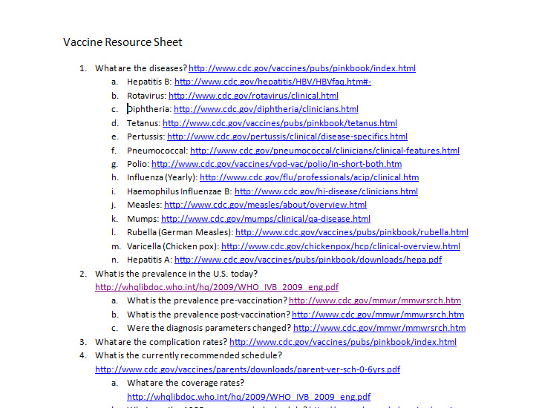
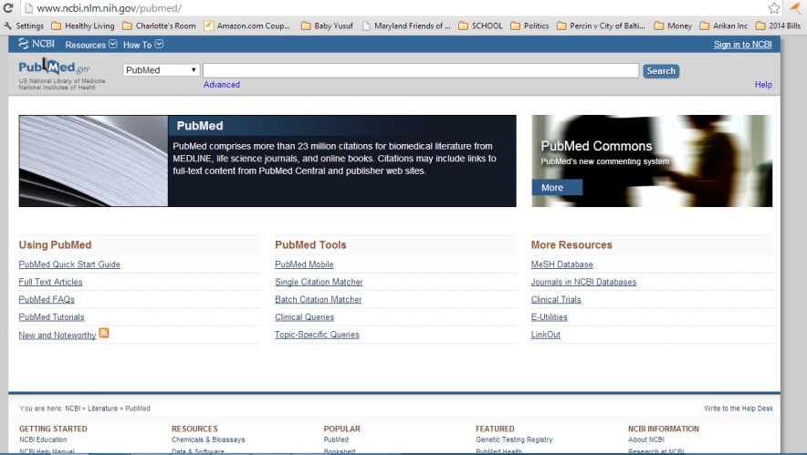
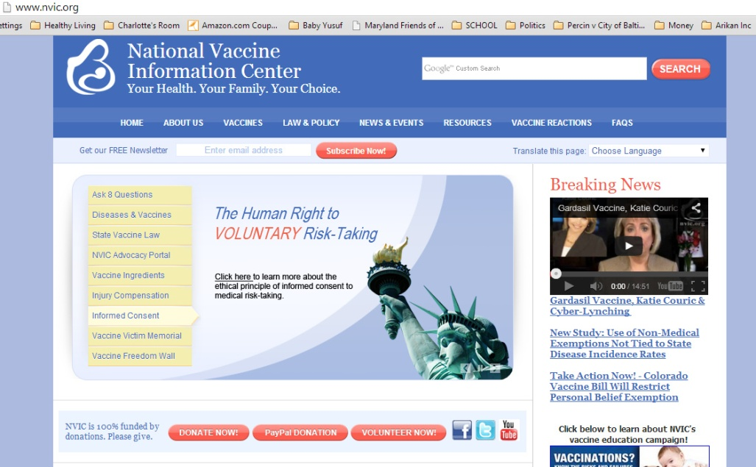
More Resources
Happy Researching!!

